Slide 1
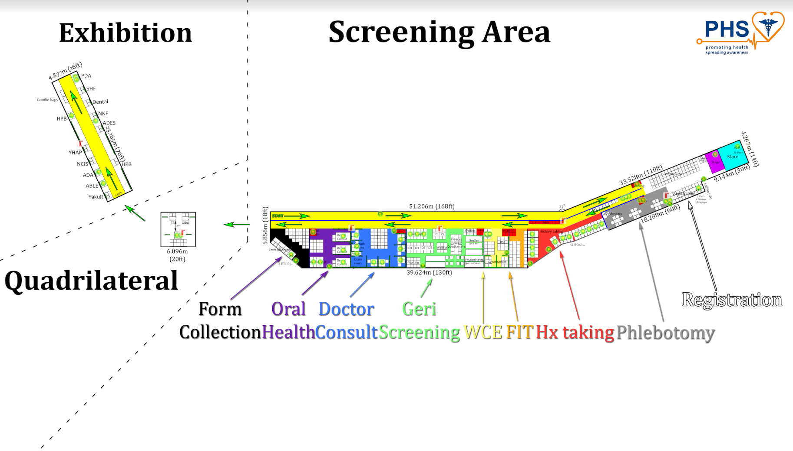
Overall layout

Slide 2




Quadrilateral layout
6.0m
CHAS
CE
Round high table
Posters/boards
Table
6.0m
CREST
Chair

Slide 3
Exhibition area layout
PAS
SHF
Dental
NKF
ADES
HPB
3.40m
2.30m
Goodie bags
HPB
YHAP
ADA
ABLE
Yakult
Posters/boards
Table
Chair

